Slide 1
Session 15 Step 4.1 Formalize, Communicate & Engage
Essential EAFm training
Date |Place

Slide 2
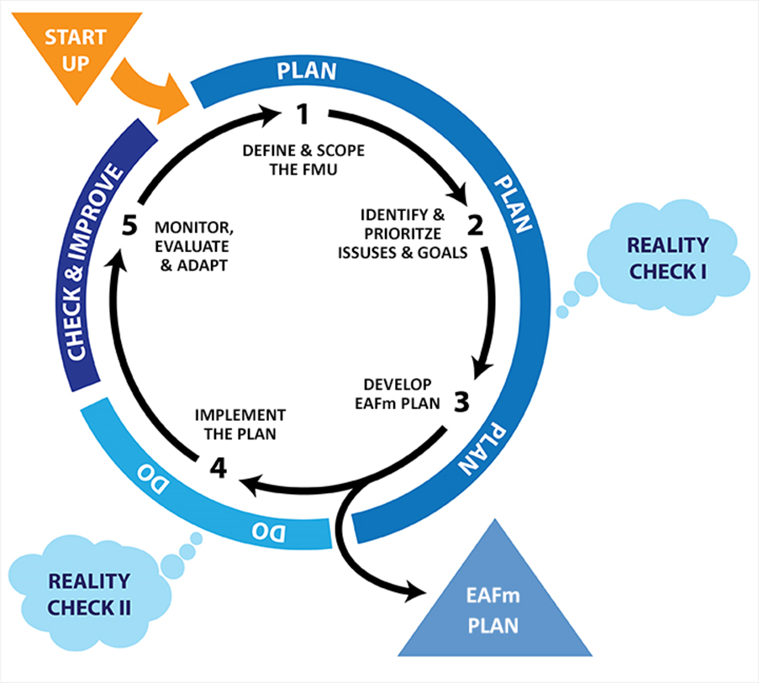
Notes:
We are now at step 4 – Implement the plan. Only 1 sub-set, which is formalize, communicate and engage.
Refer to large visual of this on wall (visuals gallery). Show where we are in course.

Slide 3
Session Objectives
After this session you will be able to:
Develop an implementation work plan
Summarize what is meant by formal adoption of the EAFm plan
Develop a communication strategy
Notes:
Self explanatory

Slide 4
Implementing the EAFm Plan
Usually governments are organised into sectors (e.g. agriculture/irrigation, fisheries, rural development)
Implementation will require working with other sector agencies
Each agency should have a clearly defined role and responsibility
Implementation at the grass roots level (e.g. fishing communities, co-management groups) will be less sectoral, but will still require coordination and cooperation across agencies
Notes:
Implementing the EAFm plan will require working with governments that are structured along sectoral lines, at least at the national and provincial levels. We do not manage ecosystems.

Slide 5
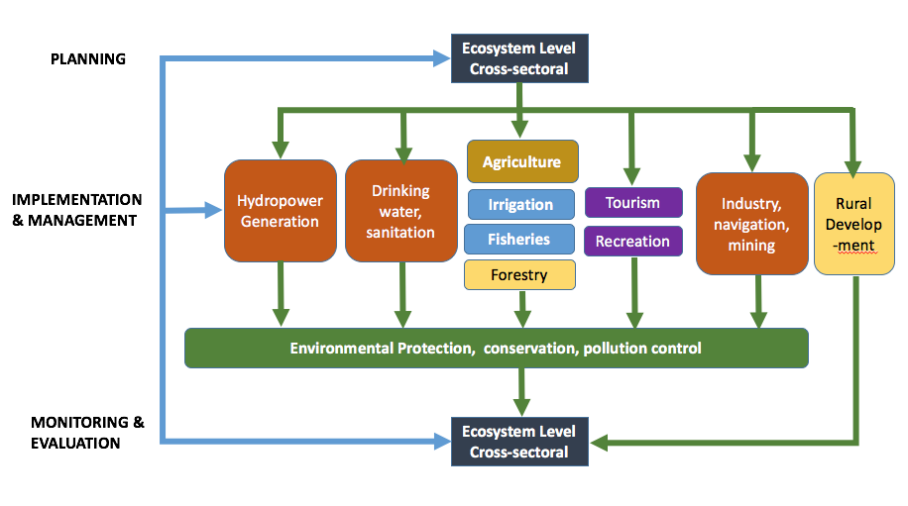
Notes:
This visual emphasizes the points made in the previous slide. STRESS, we do not manage ecosystems. The management is done through sector agencies. HOWEVER, Planning and M&E stages should be carried out at the ecosystem level. Implementation and management will require working with other sectoral agencies, including the environment protection and conservation agency.
Refer to Participant Handbook Module 15, Figure 15.1.

Slide 6
Need a work plan to help implement the EAFm Plan
EAFm plan
Implementation
workplan
Notes:
An EAFm Plan by itself will not be enough. Need to develop an Implementation work plan, which with the EAFm Plan will result in action.

Slide 7
Implementation Work Plan
WHAT tasks need to be done?
WHO does them?
WHEN will they be done?
Necessary to move ahead with implementing EAFm plan
Most effective if mainstreamed into annual budget cycles and plans, but this may take time
NEED TO WORK WITH OTHER AGENCIES
Notes:
Refer to day 2 when we talked about EAFm Plan as the link between policy and action. We agreed on the importance of planning. So to make the EAFm Plan ‘happen’ we now need to have some sort of work plan that helps the EAFm team in actually implementing what is outlined in the EAFm Plan. Need to work with other agencies. If someone is already doing the required management – form a partnership.
To generate such a work plan requires going through the full set of EAFm actions developed in Step 3 and determining (i) what are the specific tasks that need to be done; (ii) who are the actual persons/institutions that will be responsible for completing these tasks; and (iii) when will the tasks be done by.
Refer to Participant Handbook Module 15 for basic work plan format. Also see template in Workbook.

Slide 8
Implementation Work Plan
WHAT tasks need to be done?
WHO does them?
WHEN will they be done?
Includes how to formalize the EAFm Plan
Includes how to communicate the Plan
Includes how to implement the management actions
NEED TO WORK WITH OTHER AGENCIES
Notes:
Refer to day 2 when we talked about EAFm Plan as the link between policy and action. We agreed on the importance of planning. So to make the EAFm Plan ‘happen’ we now need to have some sort of work plan that helps the EAFm team in actually implementing what is outlined in the EAFm Plan. Need to work with other agencies. If someone is already doing the required management – form a partnership.
To generate such a work plan requires going through the full set of EAFm actions developed in Step 3 and determining (i) what are the specific tasks that need to be done; (ii) who are the actual persons/institutions that will be responsible for completing these tasks; and (iii) when will the tasks be done by.
Refer to Module 15 for basic work plan format. Also see template in Workbooks.

Slide 9
Formalizing the EAFm Plan
Legitimizing the Plan
Validation and “buy-in” by stakeholders
Endorsement and adoption of the plan
Plan is legally and socially enforceable by the relevant authority or groups
Notes:
Need to validate the newly agreed EAFm Plan- at whichever level is most appropriate. Otherwise it will end up as just another plan on someone's desk.

Slide 10
Formalizing the EAFm Plan
Formalization will be depend on the country
Decree
Ordinance
Proclamation
Local government acts
Important to link to existing legislation
e.g. Fishery Act, Local law
Notes:
Different countries have a different name and system for formalization. Here are some examples. Ask participants if there are any more?
NOTE: Formalizing the plan will often require also formalizing Rules & Regulation that support the plan. Some of the same mechanisms as formalizing the plan will be required.

Slide 11
Communicating the EAFm Plan
Purpose → Sharing the EAFm plan and results with target audiences
How? → Identify target audiences
→ Develop approaches for communicating with each
→ Develop key messages
→ Timing
Notes:
A communication strategy helps communicate the actual EAFm plan to all stakeholders once its been formalised. It identifies ways of communicating with different stakeholders for accessing more info/ data, consultation processes. Refer back to methods introduced as part of Startup B, and to People Toolkit.

Slide 12
Other Considerations for Communication
Depending on target audience
What is your budget for communication?
What media will be suitable and effective?
What languages?
Timing and location?
How will you know how well your message has been interpreted and understood?
Notes:
Refer to BOBLME Communications Strategy in Tool 25 in Toolkit. Have a few copies printed out of actual BOBLME strategy (6 pages) to discuss in groups. This also needs to be copied onto participant CD/USB.

Slide 13
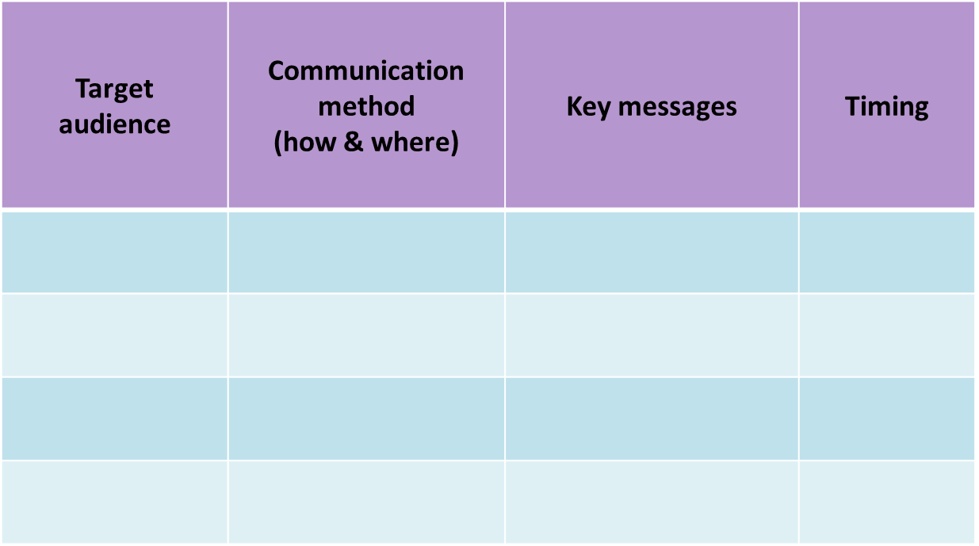
Communication Strategy
Notes:
Remember that purpose of communication strategy is to circulate/ communicate EAFm (not communications in general).
Same as in Module 15. Blank template of this can be found in participant Workbooks.
Refer to Participant Handbook Module 15, Table 15.1.

Slide 14
Key Messages
In Step 4:
The plan is formalized (to avoid being just another document on someone’s desk)
The EAFm plan needs to be communicated widely through a communication strategy
An implementation work plan is needed to put the EAFm plan into action
Notes:
Self explanatory

